Slide 1
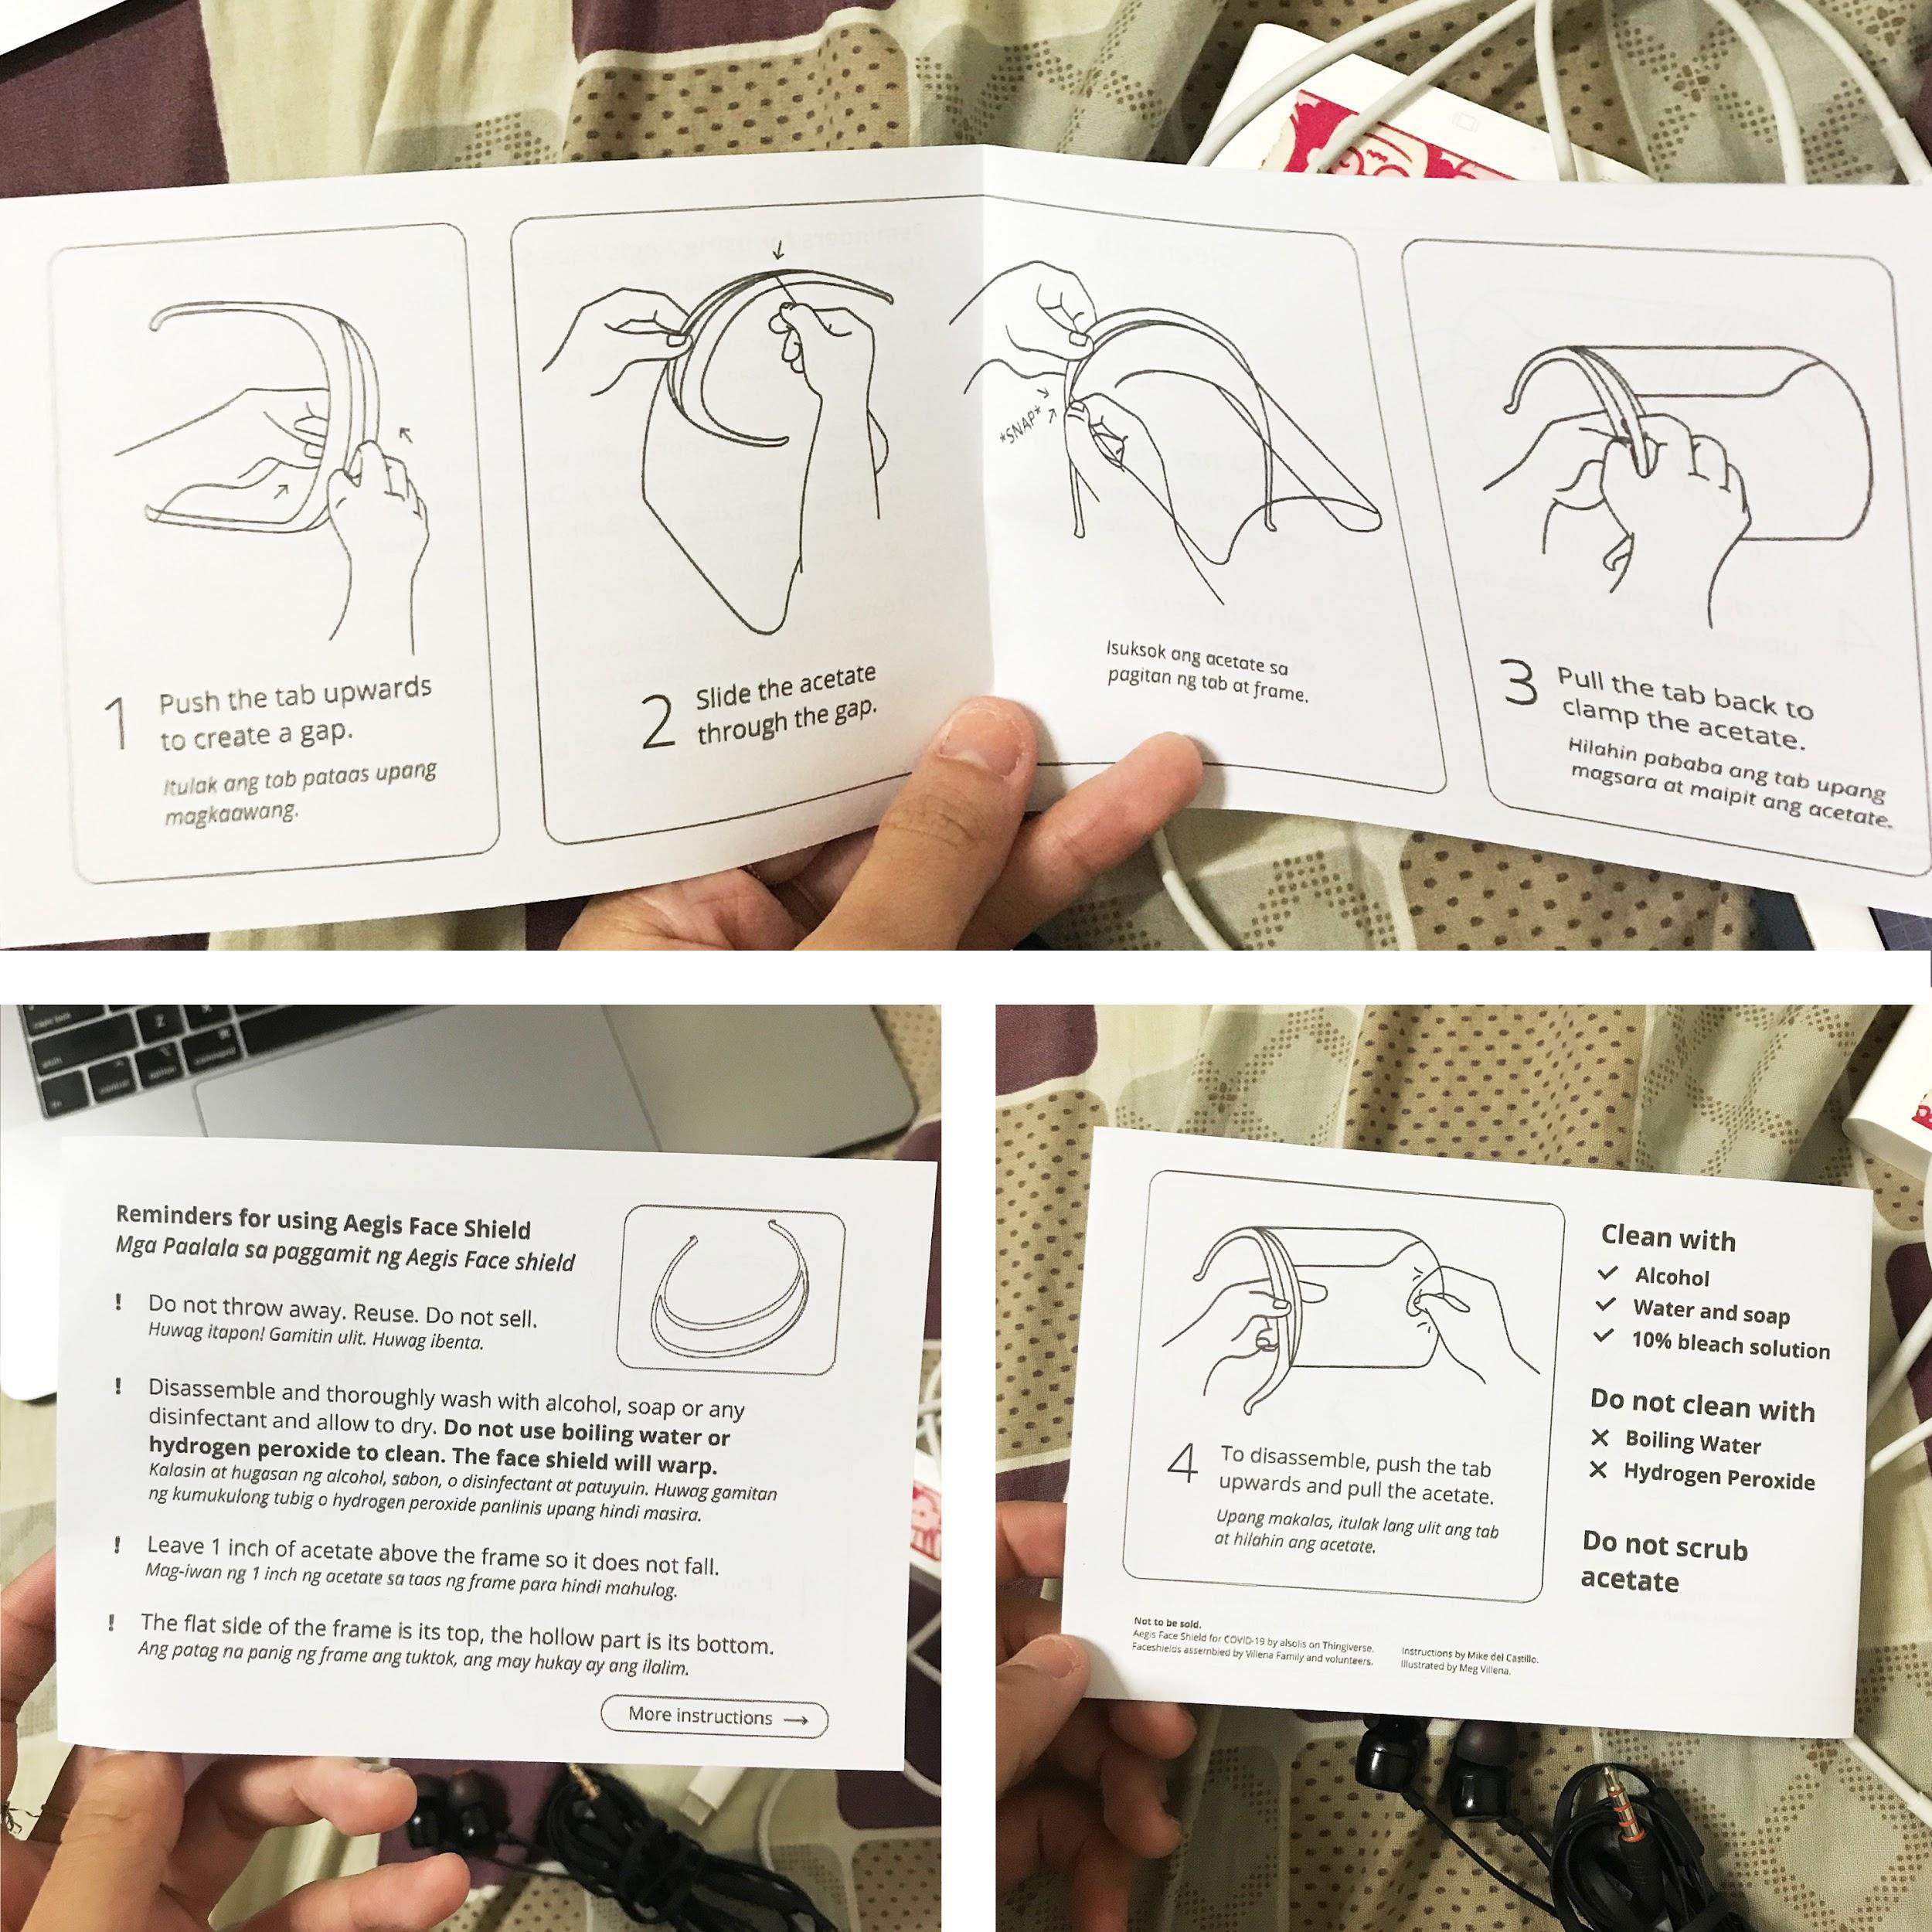
DO NOT INCLUDE THIS PAGE WHEN PRINTING
Hello!
Feel free to make a copy of this file so that you can add your own translations.
When done, print page 2 and 3 on an A4 paper.
Manual when printed on A4.
Fold in the middle.
Not to be sold.
Aegis Face Shield for COVID-19 by alsolis on Thingiverse.
Instructions by Mike del Castillo.
Illustrated by Meg Villena.

Slide 2
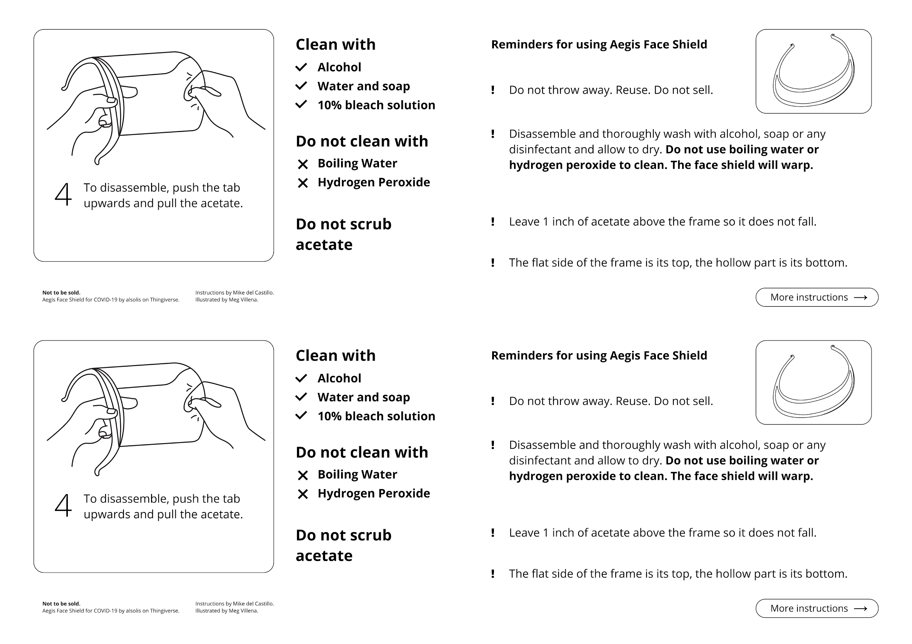
If you have any question, please email me by r.zhang@npztech.com or hello@cambridgehacklab.academy
If you have any question, please email me by r.zhang@npztech.com or hello@cambridgehacklab.academy

Slide 3
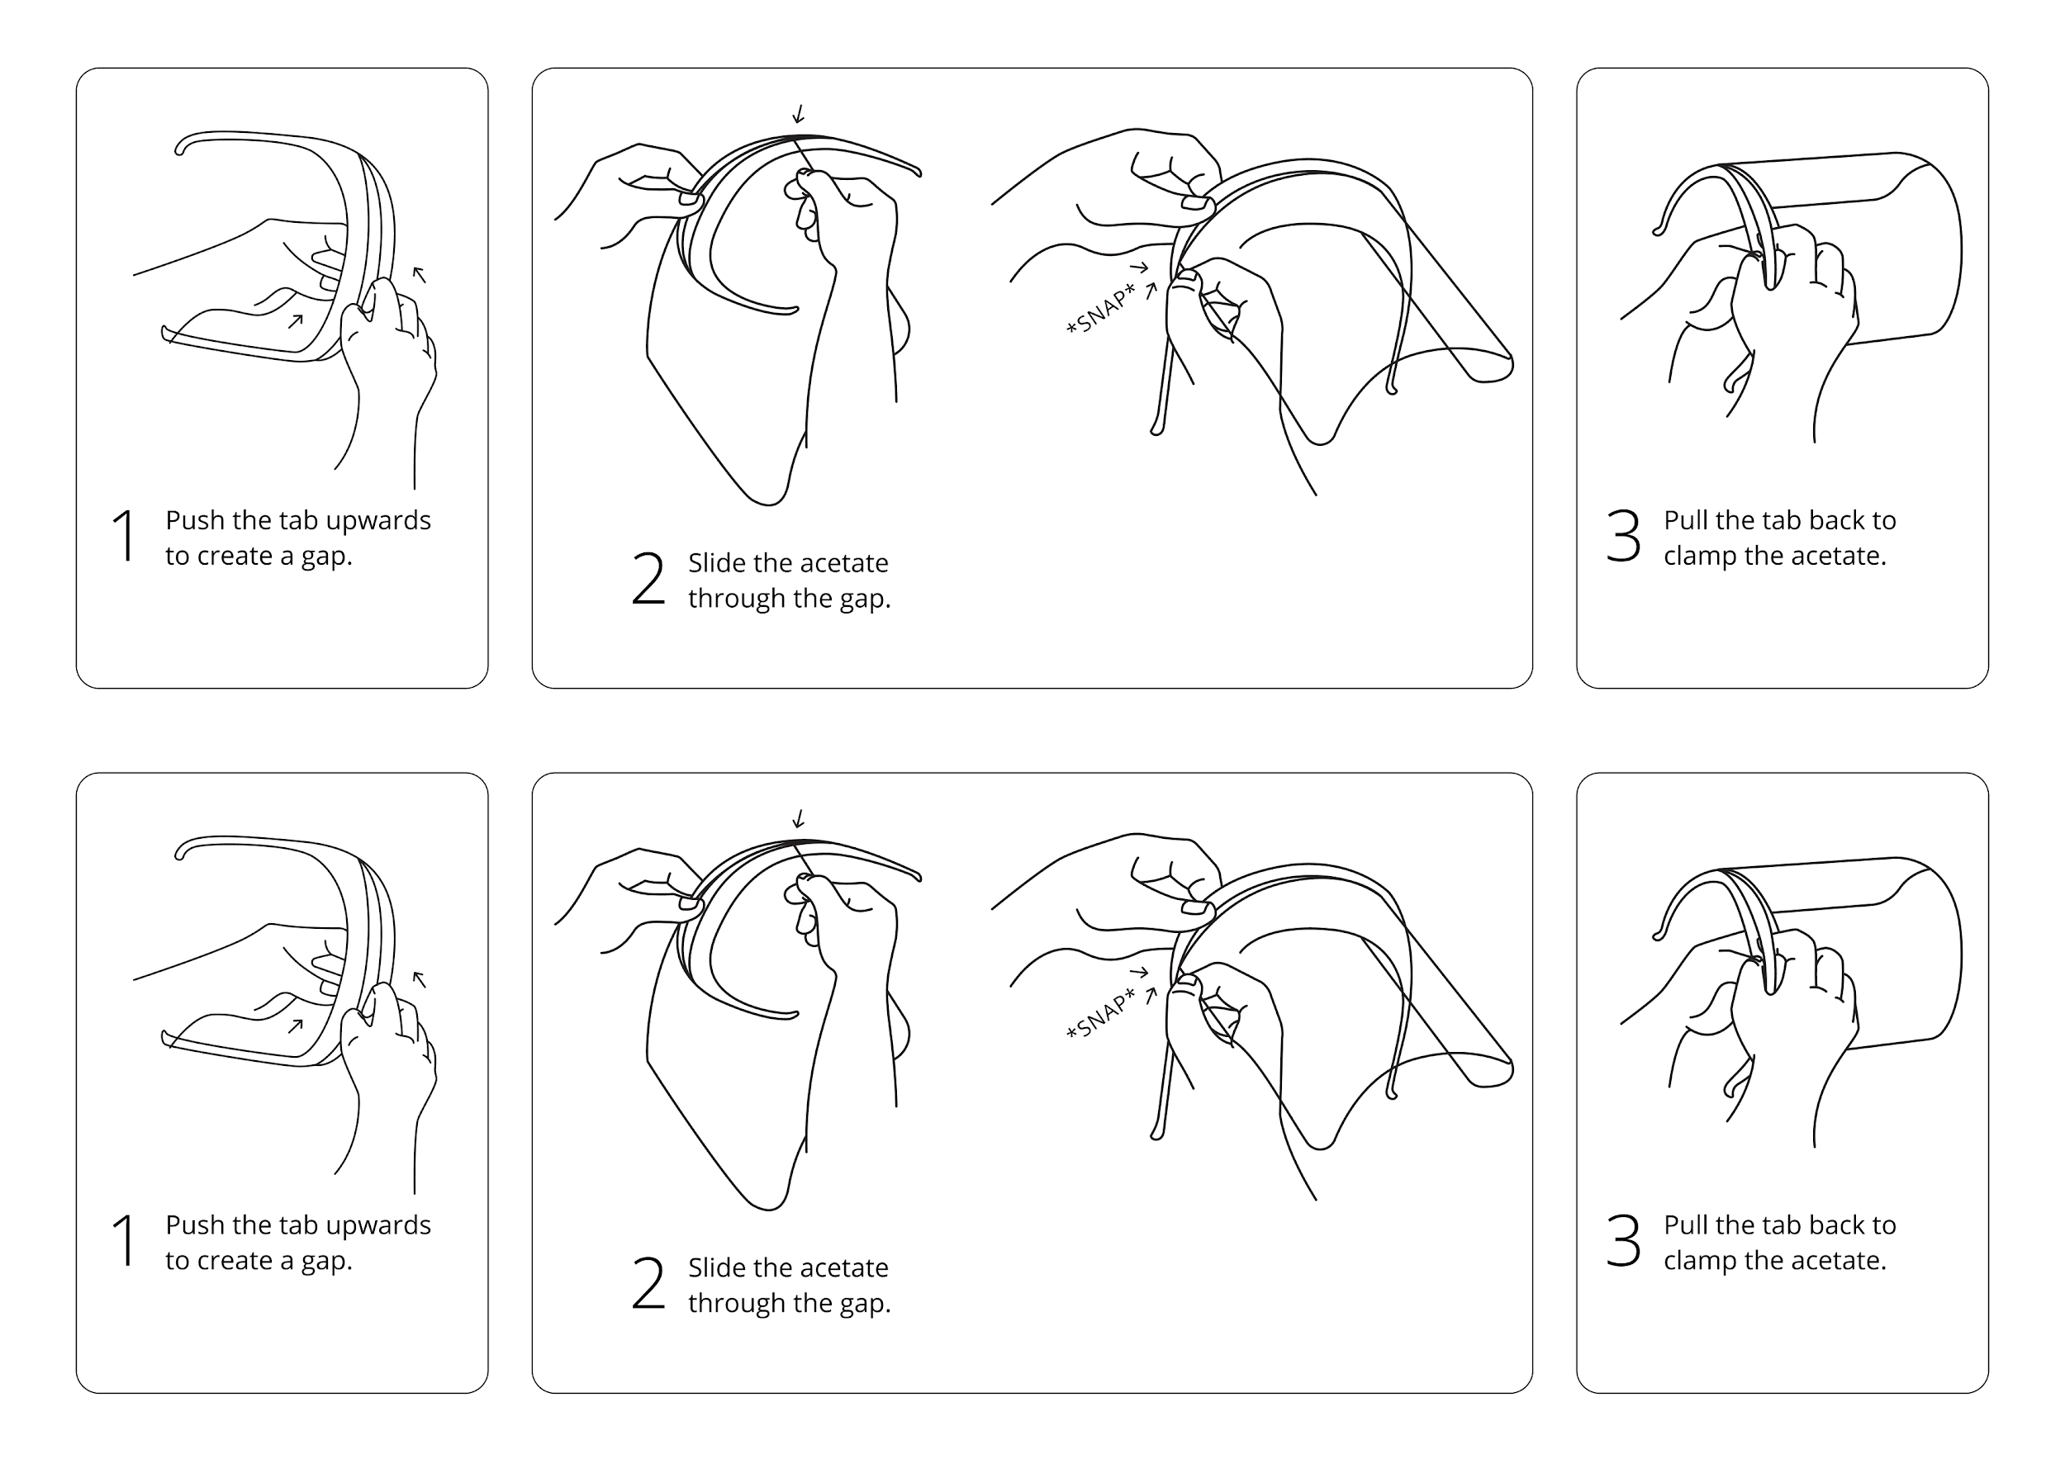
If you have any question, please email me by r.zhang@npztech.com or hello@cambridgehacklab.academy
If you have any question, please email me by r.zhang@npztech.com or hello@cambridgehacklab.academy

